Slide 1
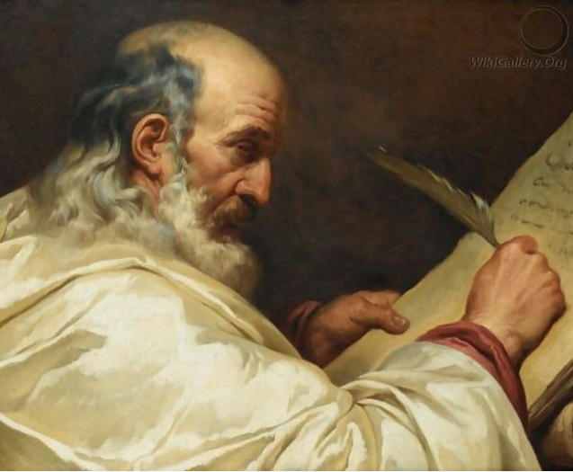

How programming has changed the way I work, 2 years in…
Before
After

Slide 2
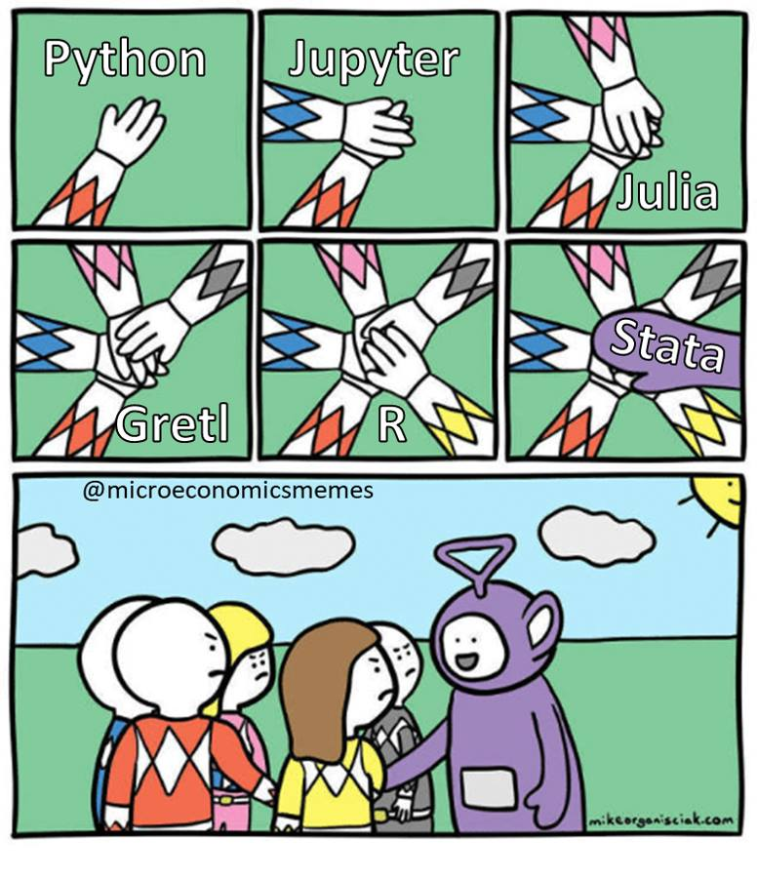
This was me 2 year ago

Slide 3

Learning has enabled me to:
Automate stuff
Scrape the web
Do better data viz
Handel bigger datasets
Analyse textual data

Slide 4
Automating stuff
Using python to automate writing reports
Matplotlib
User input
Pandas
python-docx
Data
Baseline report

Slide 5


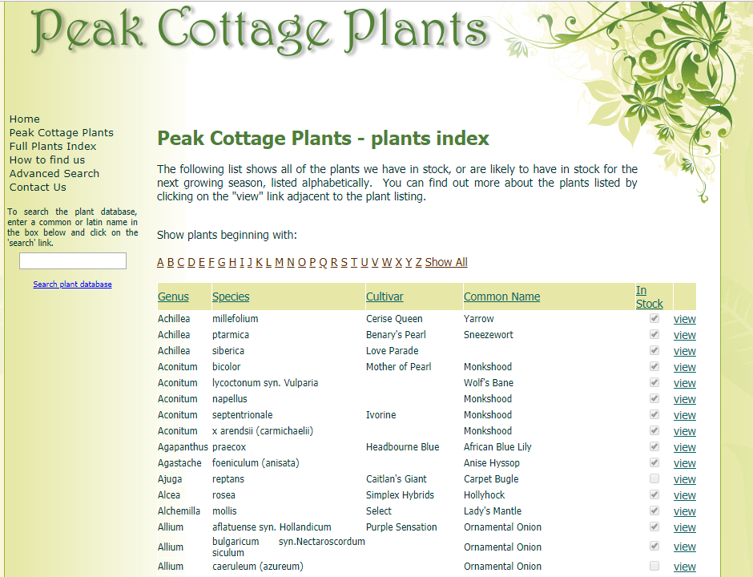
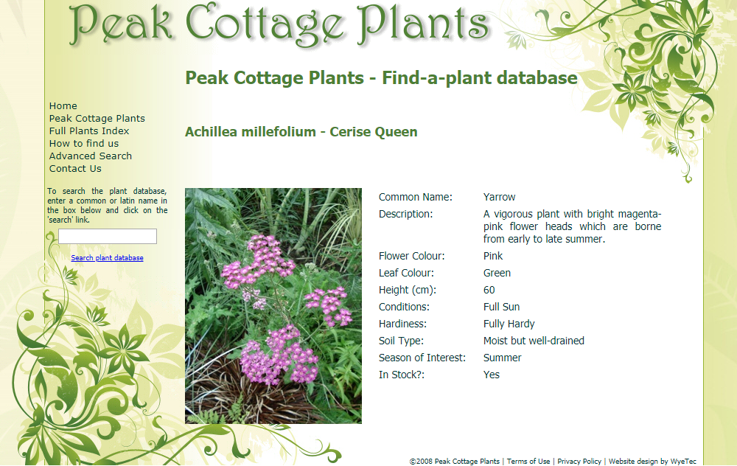
Scraping the web
JavaScript!!!
Data

Slide 6
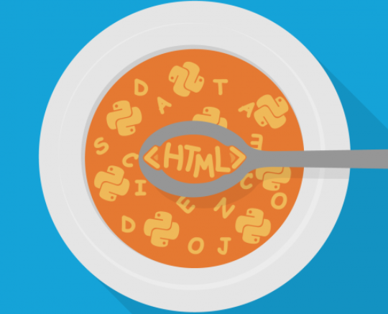
Scraping the web
Simple websites:
Use Requests & BeautifulSoup
Complex website (logins, dropdowns, JavaScript):
Use Selenium & BeautifulSoup

Slide 7
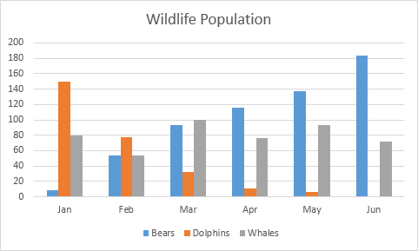
Better data viz
Limitations of excel data viz:
Labour intensive/boring
Static
Can only viz 2/3 varibles

Slide 8
Better data viz
Limitations of excel data viz:
Labour intensive/boring
Static
Can only viz 2/3 varibles
Solutions:
Plotly
Plotly
PCA

Slide 9
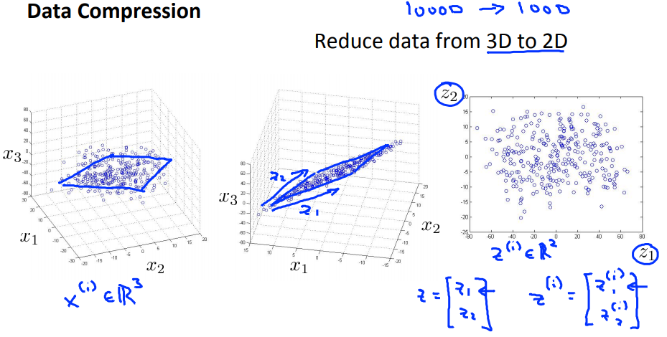
Better data viz
What is PCA (Principle Component Analysis)?

Slide 10
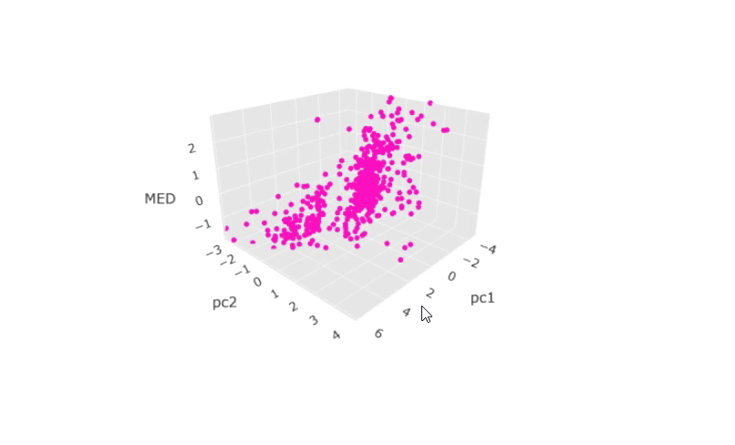
Better data viz

Slide 11
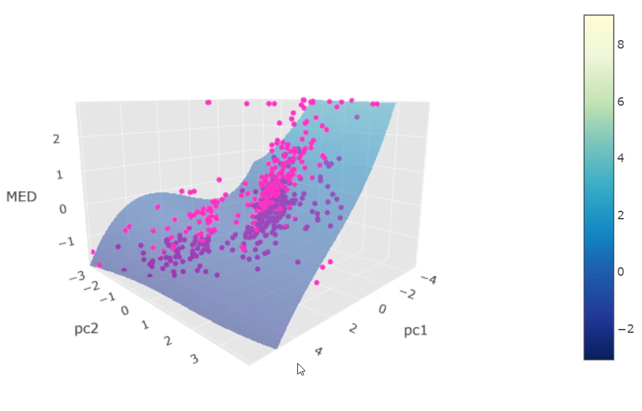
Better data viz
Polynomial regression
AI Learning System

Slide 12
Handling bigger (medium sized) data
To Reduce your memory:
Set columns of type object to category
Save as pickle (serialised object)

Slide 13

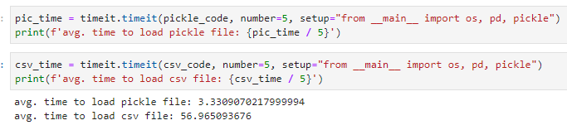
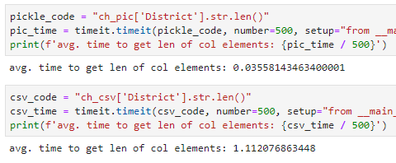
Handling big (medium) sized data
Raw CSV
Factor reduction
Pickle file
4.3
17
31

Slide 14
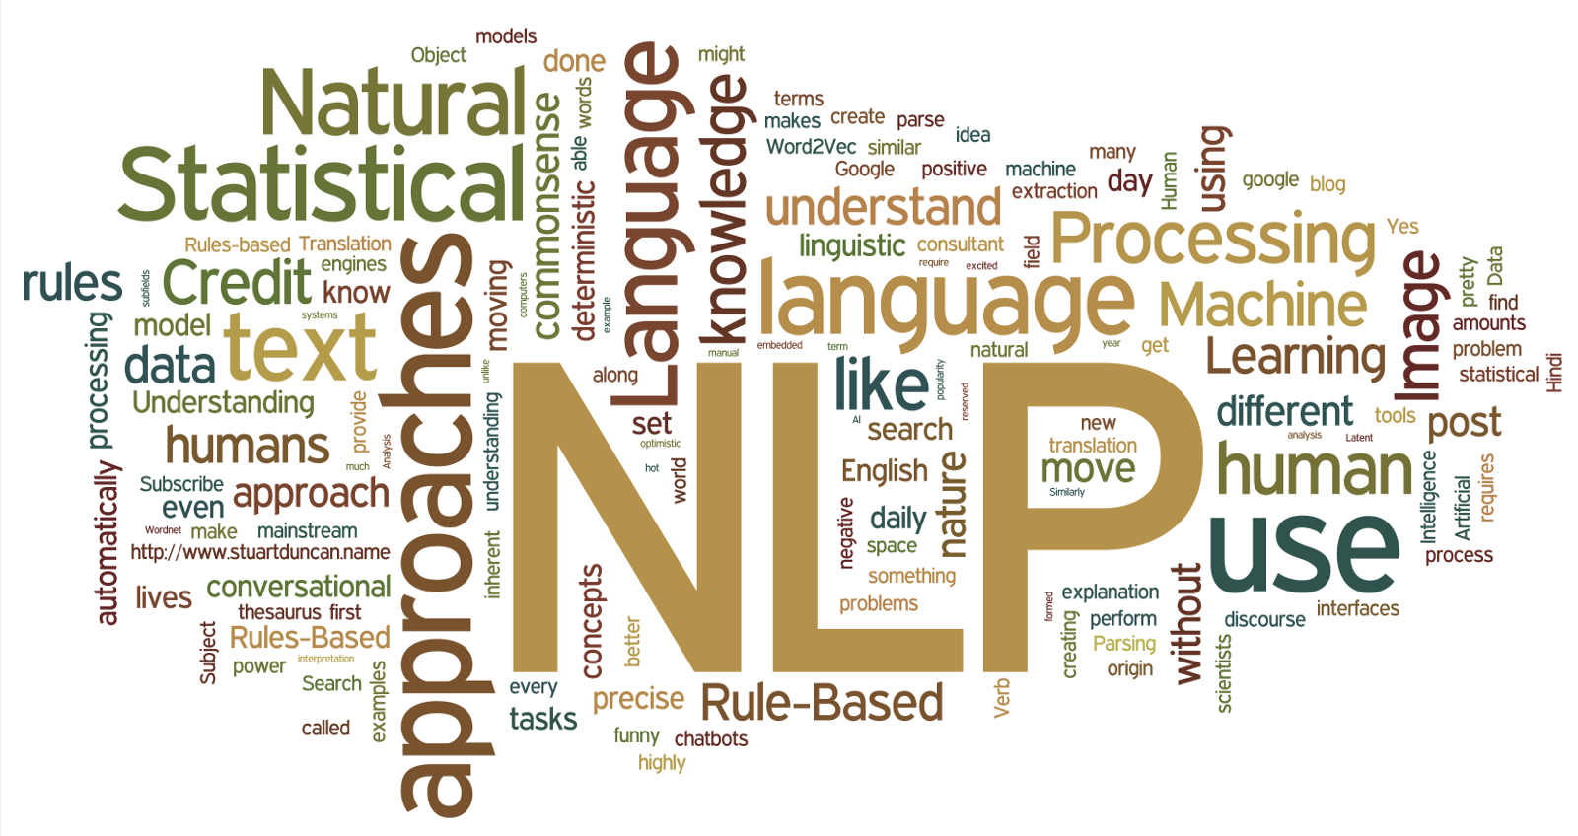
Analysing textual data
Textual data is everywhere!
Leverage on it using NLP:
Topic modelling
Text classification

Slide 15
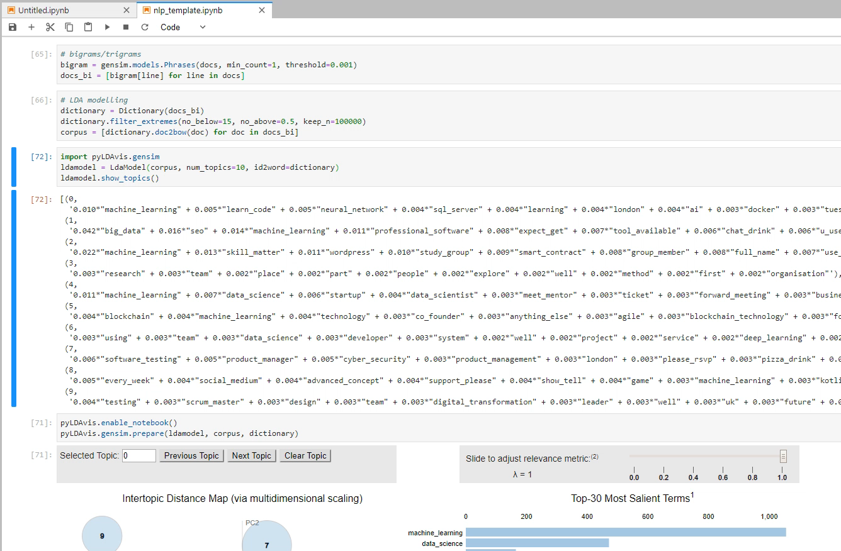

Slide 16



Analysing textual data
NLP packages in python:
NLTK
Spacy
Gensim

Slide 17
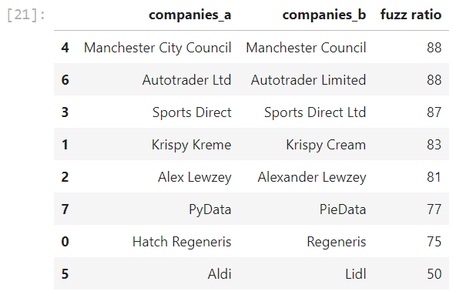
Other great uses
Regex/regular expression
Fuzzy matching
Clustering (k-means)

Slide 18
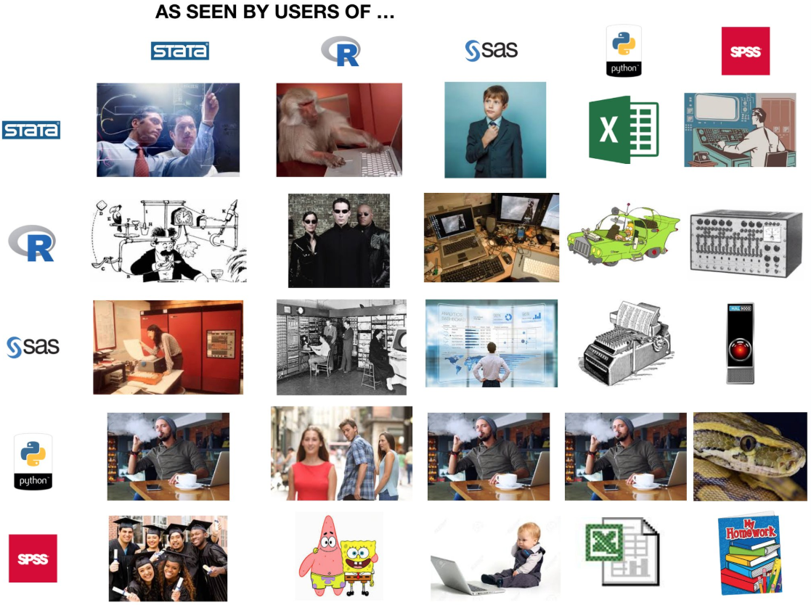
How users of …
… see users of …

Slide 19
Thanks for listening!

